Slide 1




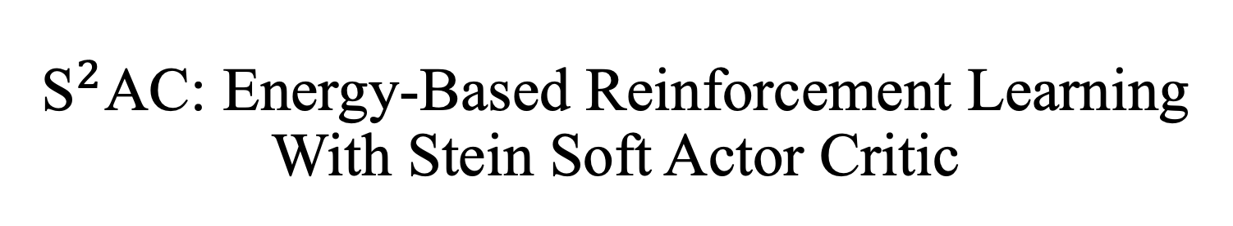
${\text{S}}^{2}$AC: Energy-Based Reinforcement Learning With Stein Soft Actor Critic
${\text{Safa} \text{Messaoud}}^{\text{1}}$, ${\text{Billel} \text{Mokeddem}}^{\text{∗}\text{1}}$, ${\text{Zhenghai} \text{Xue}}^{\text{∗}\text{2}}$, ${\text{Linsey} \text{Pang}}^{\text{3}}$, ${\text{Bo} \text{An}}^{\text{2}}$, ${\text{Haipeng} \text{Chen}}^{\text{4}}$, ${\text{Sanjay} \text{Chawla}}^{\text{1}}$
$1$ Qatar Computing Research Institute, ² NTU, ³ Salesforce, ⁴ William & Mary
ICLR 2024
Notes:
Hello everyone,
While the paper is about RL, what we really did is to introduce a new approach for scalable

Slide 2
Scalable Variational Inference With Parametrized Stein Variational Gradient Descent
Notes:
Variational inferenct. I will present the paper from this prespective. I will first abstract out the method then I will tell you how we used it to obtain a btter solution to the Max entropy RL problem.
What’s variational inference and why do we need it?

Slide 3
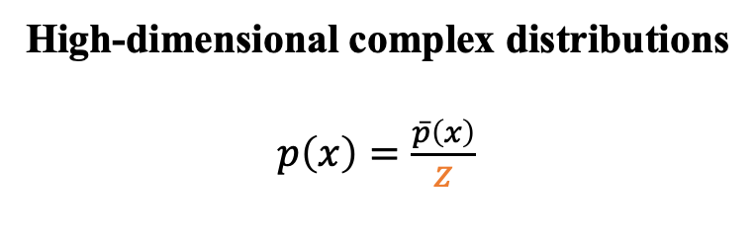
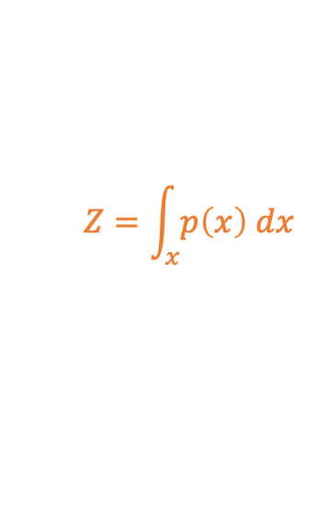
Approximate Inference
High-dimensional complex distributions
$p\left(x\right)=\frac{\overline{p}\left(x\right)}{Z}$
Draw samples?
Compute the entropy?
$$Z=\int_{x}{p\left(x\right) dx}$$
Untractable
Notes:
In many machine learning problems, we are interested in learning or sampling from a high-dimensional complex distribution known up to a normalization constant. [x]
This normalization constant is called the partition function and is, in the general case,[x] untractable to compute as it envolves integrating over an infinit number of configurations.
which makes computing the density is untractable as well.

Slide 4
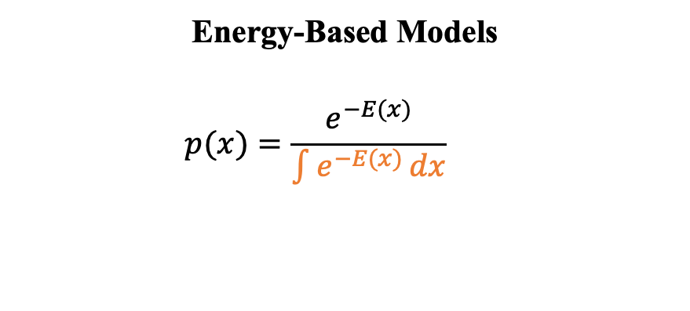
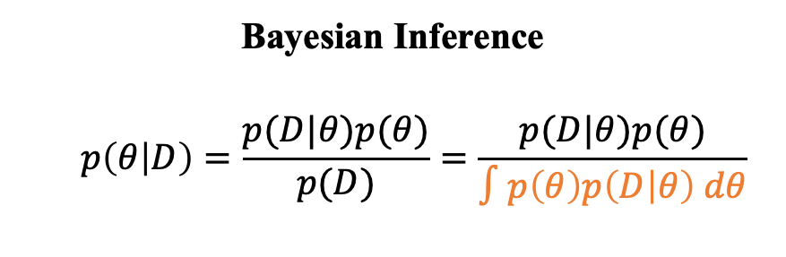
Approximate Inference
High-dimensional complex distributions
$p\left(x\right)=\frac{\overline{p}\left(x\right)}{Z}$
Draw samples?
Compute the entropy?
Bayesian Inference
$$p\left(θ | D\right)=\frac{p(D|θ)p(θ)}{p(D)}=\frac{p(D|θ)p(θ)}{∫p\left(θ\right)p\left(D | θ\right) dθ}$$
Energy-Based Models
$$p(x)=\frac{e^{−E(x)}}{\int{e^{−E(x)}}dx}$$
Bayesian Inverse RL [Ramachandran, IJCAI 2007]
Variational Auto-Encoders [Kingma, ICLR 14]
Max-Entropy RL [Ziebart, 2010]
Direct Preference Optimization [Rafailov, 2023]
Notes:
We can encounter this problem in [x] Bayesian inference where given a dataset D, evaluating the posterior over the parameters theta, requires computing the integral over the different \theta configurations. For instance, In Bayesian inverse RL, we are interested in evaluating the distribution of rewards that could explain a set of demonstrations. In variational autoencoders, we want to compute the posterior over the latent variables generated by the encoder.
Another example where [x] we enconter densities of this form is Energy Based models. Where we assume oracle access to some energy function which takes real values and characterizes configurations of x that are likely under p(x). For example in Max-Entropy RL, the policy is modeled as an EBM and the energy is equal to the negative of the Q values. In DPO, a popular alg for Large Language models alignment, the energy incorporates the reward associated with a prompt/answer pair and the SFT (supervised finetuning) policy.

Slide 5
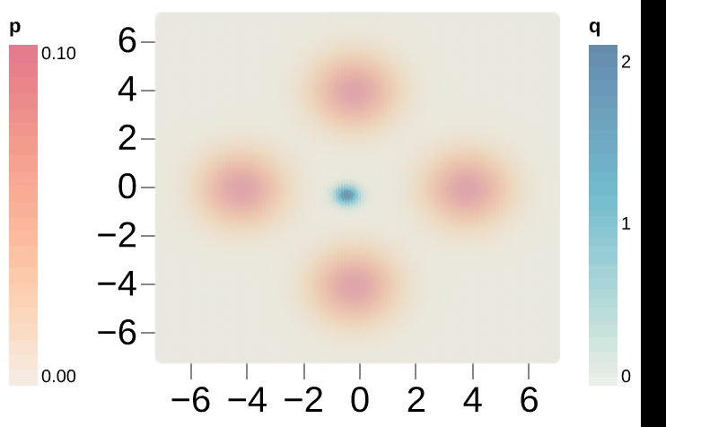
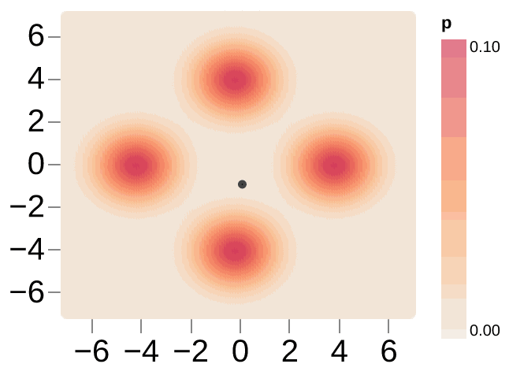
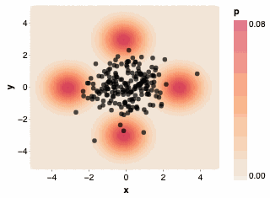
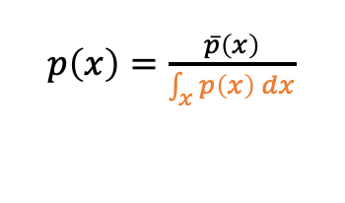
Approximate Inference
Target Distribution
$p\left(x\right)=\frac{\overline{p}\left(x\right)}{\int_{x}{p\left(x\right) dx}}$
Parametrized Variational Inference
Markov Chain Monte Carlo (MCMC)
Particle-Based Variational Inference
Notes:
Different approximate inference techniques have been developed to sample from or evaluate such distributions.
The most popular categories are : (1) parametrized variational inference, (2) Markov Chain Monte Carlo and (3) Particle Based Variational inference. I will briefly go over the main idea behind each of these techniques. Let’s start with parametrized VI [x]
.

Slide 6
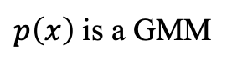
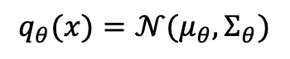
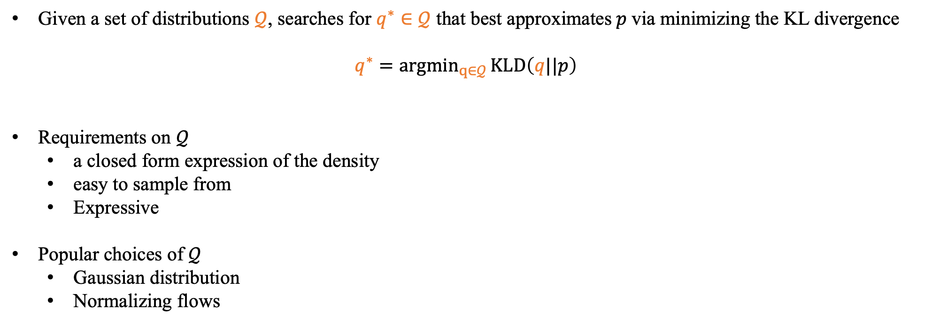
Parametrized Variational Inference
Target Distribution
$p\left(x\right)=\frac{\overline{p}\left(x\right)}{\int_{x}{p\left(x\right) dx}}$
Given a set of distributions $𝒬$, searches for $q^{∗}∈𝒬$ that best approximates$p$via minimizing the KL divergence
$$q^{∗}={argmin}_{q∈𝒬}{KLD\left(q||p\right)}$$
Requirements on $𝒬$
a closed form expression of the density
easy to sample from
Expressive
Popular choices of $𝒬$
Gaussian distribution
Normalizing flows
$p\left(x\right)$ is a GMM
$$q_{θ}(x)=𝒩(μ_{θ}, Σ_{θ})$$
✅ Fast sampling (scalable)
❌ No convergence guarantees
Notes:
In parametrized variational inference, the main idea is to approximate p by another distribution q that [x] has a tractable closed form expression of the density, is easy to sample from and is expressive enough to capture the intricacies of p. This is achieved by first selecting a class of distributions (capital Q), for instances, [x]Gaussians or Normalizing flows and then finding q that minimizes the KL divergence.
For instance, in this example, p in orange, is a Gaussian Mixture Model with 4 componenets and q is a Gaussian. We visualize the q distribution during training. Notice how we converge to a Gaussian that covers all the modes.
Such a distribution is obviously oversimplistic. Besides, parametrized VI has no convergence guarantees even if we go for a family of expressive distributions like normalizing flows.

Slide 7
Approximate Inference
Target Distribution
$p\left(x\right)=\frac{\overline{p}\left(x\right)}{\int_{x}{p\left(x\right) dx}}$
Parametrized Variational Inference
Markov Chain Monte Carlo (MCMC)
Particle-Based Variational Inference
Notes:
Another family of approximate inference techniques is the family of MCMC.

Slide 8
Markov Chain Monte Carlo (MCMC)
Target Distribution
$p\left(x\right)=\frac{\overline{p}\left(x\right)}{\int_{x}{p\left(x\right) dx}}$
Simulates a Markov Chain whose stationary distribution is close to the target $p$
SGLD [Langevin et al., 1908]
$x^{(k+1)}←x_{k}+η∇_{x^{\left(k\right)}}log p\left(x^{\left(k\right)}\right)+\sqrt{2η}ε^{\left(k\right)}, ε^{(k)}∼$ $𝒩(0,I)$
Gradient
Descent
Large Gaussian
Noise
✅ Convergence guarantees
❌ Hard to detect convergence
❌ Slow sampling (not scalable)
❌ Slow mixing (coverage of different modes)
Notes:
The basic idea behind MCMC is to design a Markov chain which stationary distribution is the target distribution.
One of the most popular algorithms is Langevin Dynamics. In this case the chain is constructed by repeatedly applying this update rule. This is basically[x] gradient descent plus some[x] large guaussian noise to encourage the samples/particles to cover the distribution and not just converge to the maximum.
Here we are visualizing the sampling for one particle. Notice how when it converges, it's hard for it to jump to different modes. We can obviously run multiple chains in parallelbut the challenge is to get equal coverage for all the modes.
[x]There are many nice asymptotic convergence analysis. However, in MCMC converegence is hard to detect, sampling is slow as well as mixing. Also, MCMC is not particle efficient, meaning we might have to run many many chains to get all the modes equally covered.

Slide 9
Approximate Inference
Target Distribution
$p\left(x\right)=\frac{\overline{p}\left(x\right)}{\int_{x}{p\left(x\right) dx}}$
Parametrized Variational Inference
Markov Chain Monte Carlo (MCMC)
Particle-Based Variational Inference
Notes:
Particle based variational inference is a relatively new sampling technique that addresses some of these limitations.

Slide 10
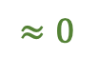
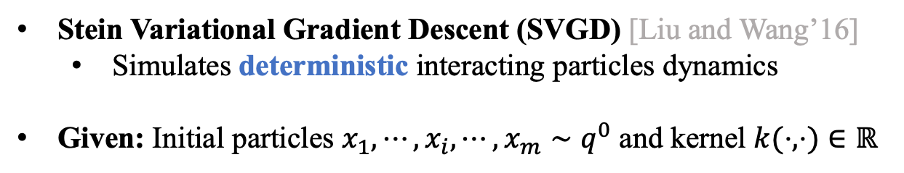
Particle-Based Variational Inference
(non-parametrized)
Target Distribution
$p\left(x\right)=\frac{\overline{p}\left(x\right)}{\int_{x}{p\left(x\right) dx}}$
Stein Variational Gradient Descent (SVGD) [Liu and Wang’16]
Simulates deterministic interacting particles dynamics
Given: Initial particles $x_{1},⋯,x_{i}, ⋯,x_{m}∼q^{0}$ and kernel $k(⋅,⋅)∈ℝ$
$$x_{i}^{(k+1)}←x_{i}^{(k)}+η𝔼_{x_{j}^{(k)}∼q^{(k)}}\left[{k\left(x_{j}^{(k)},x_{i}^{(k)}\right) ∇}_{x_{j}^{(k)}}log p\left(x_{j}^{(k)}\right)+∇_{x_{j}^{(k)}}k\left(x_{j}^{(k)},x_{i}^{(k)}\right)\right]$$
Gradient Descent
Dispersion
$$≈0$$
✅ Expressive
✅ Particle efficient (better modes coverage)
✅ Easy to detect convergence (Stein identity)
❌ No convergence guarantees
❌ Slow sampling (not scalable)
Notes:
Specifically, Stein Variational Gradient Descent was proposed around 2016.
Similarly to MCMC, it’s an iterative sampling algorithm, but differently, it simulates deterministic interacting particles dynamics. In other words, it operates on a set of particles instead of one particle at a time as it is the case of Langevin Dynamics.
So, given some initial particles sampled from some initial distribution, and a kernel function,
The value of particle x_i at the k+1 th time step depends on its previous value as well as on its interaction with all the other particles at the kth time step.
The first term here [x]is a gradient descent term saying follow the gradient of your neigbours to the high density region. The second term is [x] a repulsion term pushing the particles apart.
It has been shown that under some regularity conditions, The emprical distribution induced by SVGD can [x]closely approximate arbitrary distributions. Besides, because SVGD operates on a set of particles, it naturally pushes these particles to different modes ensuring better mode coverage.
Convergence is easy to detect using the Stein Identity which basically says that this term is equalt to 0 at convergence. This is a really nice and useful property that MCMC methods don’t have.
However, SVGD doesn’t have convergence guarantees and simlartly to MCMC, this iterative sampling procedure can be very slow.

Slide 11
Approximate Inference
Target Distribution
$p\left(x\right)=\frac{\overline{p}\left(x\right)}{\int_{x}{p\left(x\right) dx}}$
Parametrized Variational Inference
✅ Fast sampling (scalable)
❌ No convergence guarantees
Markov Chain Monte Carlo (MCMC)
Particle-Based Variational Inference
✅ Convergence guarantees
❌ Hard to detect convergence
❌ Slow sampling (not scalable)
❌ Slow mixing (coverage of different modes)
✅ Particle efficient (better modes coverage)
✅ Easy to detect convergence (Stein identity)
✅ Expressive
❌ No convergence guarantees
❌ Slow sampling (not scalable)
Notes:
To summarize, these techniques have each several advantages and disadvantages. The ideal approximate inference algorithm would have the combined advantages of each of these approaches.
Which motivates designing techniques to bridge the gap.

Slide 12
Approximate Inference
Target Distribution
$p\left(x\right)=\frac{\overline{p}\left(x\right)}{\int_{x}{p\left(x\right) dx}}$
Parametrized Variational Inference
✅ Expressive
✅ Fast sampling (scalable)
✅ Easy to detect convergence
❌ No convergence guarantees
P-SVGD
[Messaoud et al., 2023]
Markov Chain Monte Carlo
(MCMC)
Particle-Based
Variational Inference
Notes:
This is exactly what we tried to do. We designed P-SVGD, an approximate inference algorithm at the intersection of parametrized variational inference and Particle based VI to get the best of both words: [x]expressivity, fast sampling and the ability to easily detect converegence.
Our algorithm doesn’t have converegence guarantees but this intersection is sth that we are investigating in the future.
The main idea of P-SVGD is to first compute a closed form expression of the SVGD induced distribution then parametrize it to enable fast sampling.
Let me tell you how we did it:

Slide 13
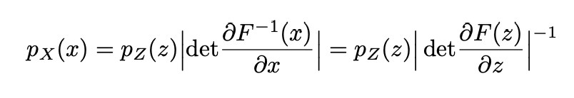
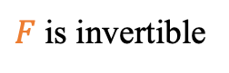
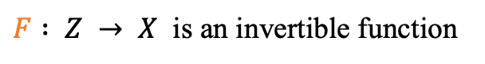
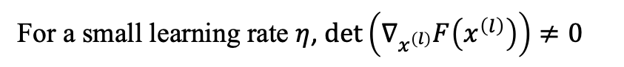
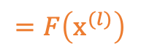
P-SVGD: A Closed Form Expression Of The SVGD Distribution
The Change Of Variable Formula (CVF)
$F : Z → X$ is an invertible function
SVGD Update
$$x_{}^{(l+1)}←x^{(l)}+η𝔼_{x_{j}^{(l)}}\left[{k\left(x_{j}^{(l)},x^{(l)}\right) ∇}_{x_{j}^{(l)}}log p\left(x^{(l)}\right)+∇_{x_{j}^{(l)}}k\left(x_{j}^{(l)},x^{(l)}\right)\right]$$
$$=F\left(x^{(l)}\right)$$
Invertability
Implicit Function Theorem
For a small learning rate $η$, $\det\left(∇_{x^{\left(l\right)}}F\left(x^{\left(l\right)}\right)\right)≠0$
$F$ is invertible
Notes:
Our derivation is based on the change of variable formula of pdfs.
Which state that given an invertible transformation that transforms a random variable z into a random variale X. If you know the density of z, p_z here, you can compute the expression of the density of x in closed form. The expression of x depends on the jaccobian of the transformation.
We showed that the SVGD update rule [x] is invertable for a small enough learning rate eta by leveraging the implicit function theorem. [x]This allowed us to apply the CVF to get a closed form expression of the distr of the SVGD particles at convergence.

Slide 14
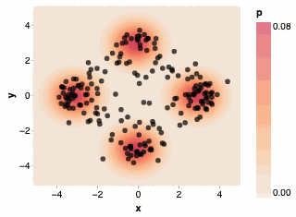
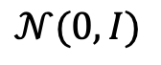
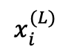
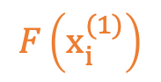
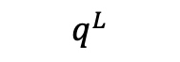
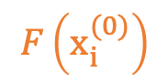
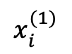
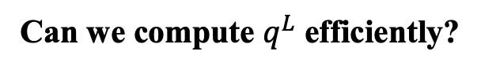
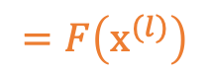
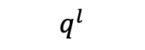
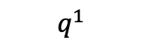
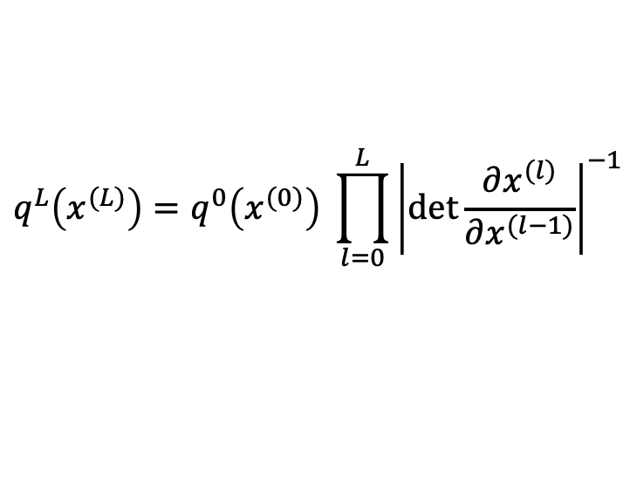
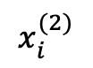
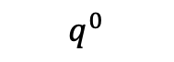
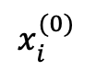
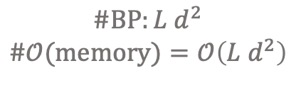
P-SVGD: A Closed Form Expression Of The SVGD Distribution
$$x_{}^{(l+1)}←x^{(l)}+η𝔼_{x_{j}^{(l)}}\left[{k\left(x_{j}^{(l)},x^{(l)}\right) ∇}_{x_{j}^{(l)}}log p\left(x^{(l)}\right)+∇_{x_{j}^{(l)}}k\left(x_{j}^{(l)},x^{(l)}\right)\right]$$
$$=F\left(x^{(l)}\right)$$
$$F\left(x_{i}^{(0)}\right)$$
$$F\left(x_{i}^{(1)}\right)$$
$$x_{i}^{(0)}$$
$$x_{i}^{(1)}$$
$$x_{i}^{(2)}$$
$$x_{i}^{(L)}$$
$$q^{0}$$
CVF
$$q^{1}$$
CVF
$$q^{l}$$
CVF
$$q^{L}$$
$$𝒩(0,I)$$
$$q^{L}\left(x^{(L)}\right)=q^{0}\left(x^{(0)}\right) \prod_{l=0}^{L}{{\left|\det{\frac{∂x^{(l)}}{∂x^{(l−1)}}}\right|}^{−1}}$$
Can we compute $q^{L}$ efficiently?
$$\#BP:L d^{2}$$
$$\#𝒪(memory)=𝒪\left(L d^{2}\right)$$
Notes:
Let me show you a visualization of the process:
given a target distribution p, a GMM here, and a bunch of particles sampled from the initial distr q^0 which is a normal distr in this example, we apply the SVGD update rule F at every iterationto each of the particles [x] [x], …and at every iteration the transformed variables distribution can be computed in closed form using the CVF. Eventually, we obtain the distribution of the particles at convergence which is equal to the the initial distribution multiplied with the absolute value of the Jacobian of the the partcles at every step with respect to the previous step.
While this is nice, it is also computationally expensive, to compute this formula,we need to store and compute these jaccobian matrices which envolves L d^2 back propagations. d is the dimensionality of x and L is the number of SVGD steps.
[x]
Next I will show you that it’s possible to compute q^L efficiently using some approximations

Slide 15

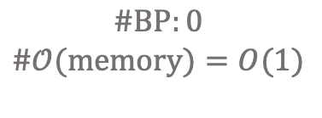
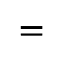
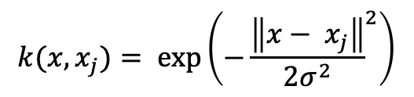
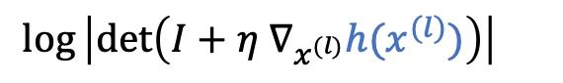
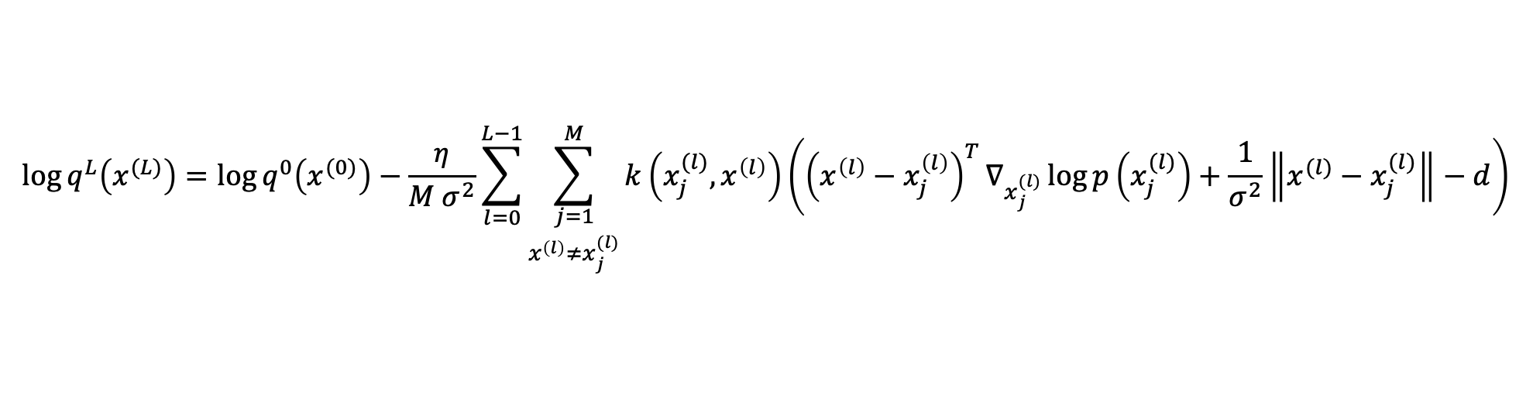
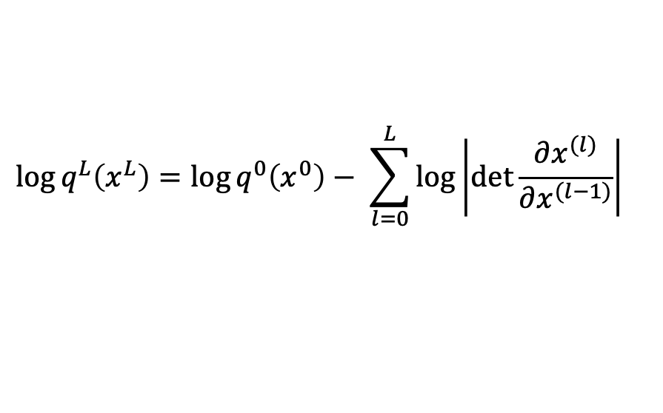
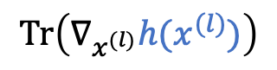
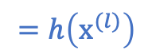
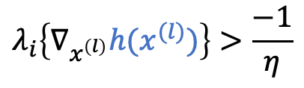
An Efficient Closed Form Expression Of The SVGD Distribution
$$x_{}^{(l+1)}←x^{(l)}+η𝔼_{x_{j}^{(l)}}\left[{k\left(x_{j}^{(l)},x^{(l)}\right) ∇}_{x_{j}^{(l)}}log p\left(x^{(l)}\right)+∇_{x_{j}^{(l)}}k\left(x_{j}^{(l)},x^{(l)}\right)\right]$$
$$=h\left(x^{(l)}\right)$$
SVGD Distribution
$$\log{q^{L}\left(x^{L}\right)}=\log{q^{0}\left(x^{0}\right)}− \sum_{l=0}^{L}{\log\left|\det{\frac{∂x^{(l)}}{∂x^{(l−1)}}}\right|{}}$$
$$=$$
$$\log\left|\det\left(I+η ∇_{x^{(l)}}h(x^{(l)})\right)\right|{}$$
$$≈$$
Assumption:
$$λ_{i}\left\{∇_{x^{\left(l\right)}}h(x^{(l)})\right\}>\frac{−1}{η}$$
$$\operatorname{Tr}\left(∇_{x^{(l)}}h(x^{(l)})\right)$$
$$k(x,x_{j})= exp⁡\left(−{\frac{\left\|x− x_{j}\right\|}{2σ^{2}}}^{2}\right)$$
RBF kernel:
$$\log{q^{L}\left(x^{(L)}\right)}=\log{q^{0}\left(x^{(0)}\right)}−\frac{η}{M σ^{2}}\sum_{l=0}^{L−1}{\sum_{\begin{aligned}j=1 \\ x^{\left(l\right)}≠x_{j}^{(l)}\end{aligned}}^{M}{k\left(x_{j}^{(l)},x^{\left(l\right)}\right)}}\left({\left(x^{\left(l\right)}−x_{j}^{\left(l\right)}\right)}^{T}∇_{x_{j}^{(l)}}\log{p\left(x_{j}^{(l)}\right)}+\frac{1}{σ^{2}}\left\|x^{(l)}−x_{j}^{(l)}\right\|−d\right)$$
$$\#BP:0$$
$$\#𝒪(memory)=O(1)$$
Notes:
Let’s denote by h the expectation term in the SVGD update rule.
This [x]is again the SVGD distribution from the last slide, we just applied a log on both sides.
[x]The det of the Jaccobian is is equal to Identity plus eta multiplied by grad of h. Log absolute value of det of Identity + jaccobian of another matrix can be approximated as the trace of the Jaccobian under the assumption that the eigenvalues are larger than -1/ learning rate
If we choose a small enough learning rate this should be easy to statisfy
[x]In the case of the RBF kernel, we can derive the following expression for the log likelihood which doesn’t depend on any matrix computation, it only depends on vector dot products and the score function, which we compute anyways for the SVGD update. [x] Our formula can be computed without any additional BPs and or memory complexity, as these distances are computed for the kernel as well.

Slide 16
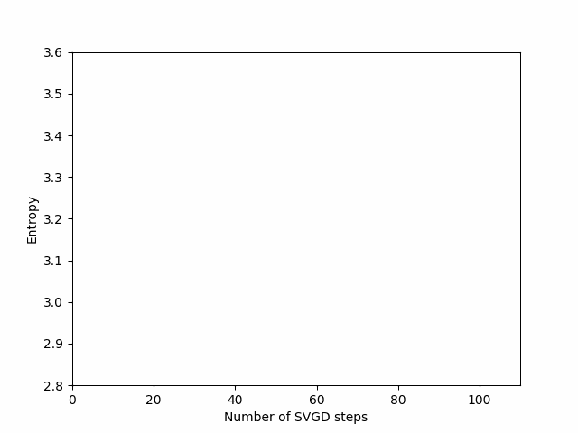
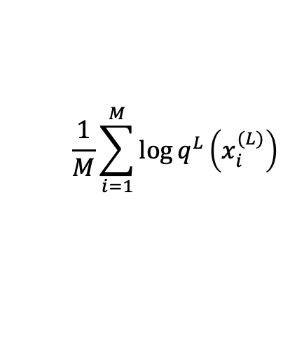
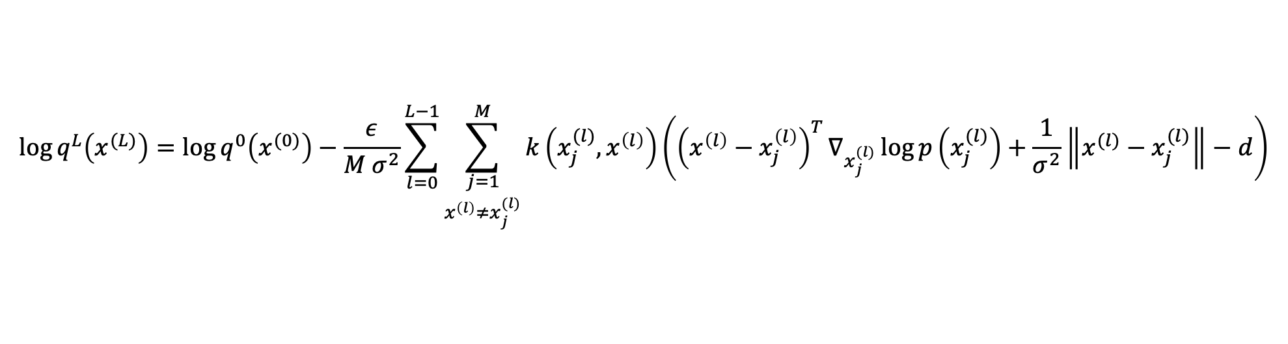
An Efficient Closed Form Expression Of The SVGD Distribution
$$x_{}^{(l+1)}←x^{(l)}+η𝔼_{x_{j}^{(l)}}\left[{k\left(x_{j}^{(l)},x^{(l)}\right) ∇}_{x_{j}^{(l)}}log p\left(x^{(l)}\right)+∇_{x_{j}^{(l)}}k\left(x_{j}^{(l)},x^{(l)}\right)\right]$$
$$=h\left(x^{(l)}\right)$$
SVGD Distribution
$$\log{q^{L}\left(x^{(L)}\right)}=\log{q^{0}\left(x^{(0)}\right)}−\frac{ε}{M σ^{2}}\sum_{l=0}^{L−1}{\sum_{\begin{aligned}j=1 \\ x^{\left(l\right)}≠x_{j}^{(l)}\end{aligned}}^{M}{k\left(x_{j}^{(l)},x^{\left(l\right)}\right)}}\left({\left(x^{\left(l\right)}−x_{j}^{\left(l\right)}\right)}^{T}∇_{x_{j}^{(l)}}\log{p\left(x_{j}^{(l)}\right)}+\frac{1}{σ^{2}}\left\|x^{(l)}−x_{j}^{(l)}\right\|−d\right)$$
Neighborhood
Curvature
Scattering
Entropy
$$\frac{1}{M}\sum_{i=1}^{M}{\log{q^{L}\left(x_{i}^{(L)}\right)}}$$
Notes:
Once we have the loglikelohood, we can easily compute an entropy estimate by computing the emperical mean of the likelihood over these particles.
This is a visualization of the entropy estimation of a GMM. The target distr is a GMM with 4 componenets. The black dots are the SVGD particle. The initial distr is a small Gaussian blob at the center. We visualize the SVGD sampling procedure. Notice how the particles are spreading to cover different modes.
On the right side, we visualize the entropy curve of the particles througout the SVGD iterations. Notice how the entropy is increasing as the particles are spreading and eventually converges.
Next, I will show you how we used this entropy estimator to find a more optimal solution to the MaxEntr RL objective.

Slide 17
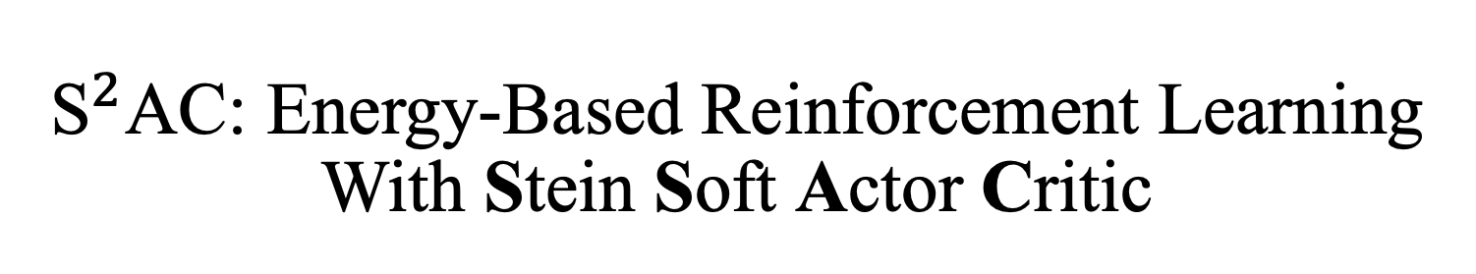
${\text{S}}^{2}$AC: Energy-Based Reinforcement Learning With Stein Soft Actor Critic
Notes:
We call our alg S2AC for

Slide 18
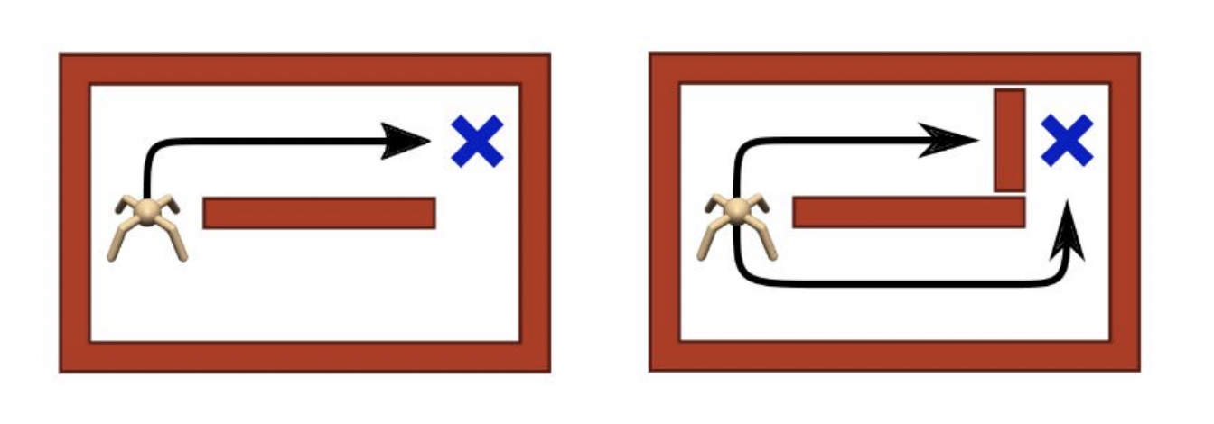
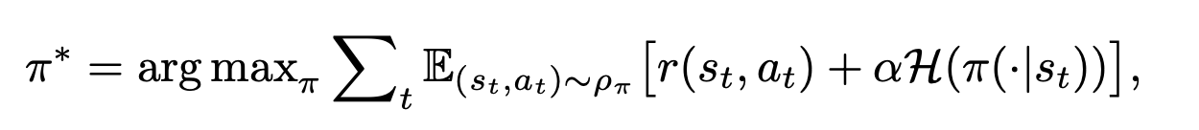


Max-Entropy Reinforcement Learning
$→$ Stochastic policy
Expected future reward
Expected future entropy
$$π^{∗}\left(a | s\right)=\frac{exp⁡(Q(s,a))}{Z}$$
https://bair.berkeley.edu/blog/2017/10/06/soft-q-learning/
Optimal Solution:
How can we estimate the entropy of EBMs?
Notes:
In max entropy reinforcement learning, the goal is not to just maximize [x]the expected future reward as classically but also we want to jointlty [x]maximize the expected future entropy. MaxEntr RL was proposed to improve the exploration of RL algo and has recently been shown to be provably robust.
Let me show you want the optimal solution to this objective then I will show you an example to give you a better intuition of why this is useful.
[x]The optimal solution is an EBM over Q values. Q(s,a) is the expected future reward at state s if we take action a.
Which means that the policy is actually a distribution. This is different from classical RL where the policy is deterministic, meaning at a given state s, we lean one point estimate a^*.
Why is this useful to be stochastic?[x] Consider this environment where we have a quadraplet trying to reach the goal blue cross. Let’s say we train it with classical RL and it learns to get to the reward following this upper path. Now, at test time, if I were to[x] perturb the env by placing an obstacle along the path that it found, it will get stuck, however, if we learn a distribution, it will hopefull sample a different action and won’t get stuck.
This is all great, but we already know that we can’t [x]evaluate a distribution of this form because of the partition function nor can we compute its entropy.

Slide 19
Max-Entr RL: Landmark Algorithms
Soft Q-learning (SQL) [Haarnoja et al., ICML 2017]
✅ Implicit entropy computation
❌ Not scalable (uses importance sampling)
Soft Actor Critic (SAC) [Haarnoja et al., ICML 2018]
✅ Tractable entropy estimate (policy = Gaussian)
❌ Limited to unimodal policies
$→$ Stochastic policy
Can we learn a better solution to the MaxEntr RL objective
Notes:
To address this, two major classes of algs have been proposed: SQL and SAC
SQL[x] implicitly estimates the entropy. For this it learns the value function in addition to the Q-values and enforces consistency between the two quantities, then it uses SVGD to sample from the Q-values. SQL is actually hard to train and scales poorly in practice due to the additional complexity.
The second class of techniques is Soft Actor critic follow a variational inference procedure to approximate the EBM. We said earlier that the variational distr should be both expressive, easy to sample from and have a tractable entropy estimate. SAC approximates the EBM via a Gaussian which is obviously not expressive it can only capture unimodal distr but it has a tractable entropy estimate which allows learning Q values to maximize this objective
[x]

Slide 20






${\text{S}}^{2}$AC: Stein Soft Actor Critic
$$π_{θ}^{∗}\left(a | s\right)=\frac{exp⁡(Q_{φ}(s,a))}{Z}$$
Main idea: Model the policy as an SVGD sampler
Critic Update: Learn the Q-values by optimizing the Bellman loss
$$q_{θ}^{L}$$
$$q_{θ}^{L}$$
Actor Update: Learn the actor (SVGD sampler) parameters via variational inference
$$θ^{∗}={argmin}_{θ}{KLD\left(q_{θ}^{L}(s|a)\left\|\frac{e^{Q_{φ}(s,a)}}{Z}\right.\right)}$$
Notes:
In this conrtext, we propose S2AC which is an actor critic alg like SAC but models thepolicy as an SVGD sampler for which as we showed earlier we can compute a closed form expression of the entropy and is expressive enough.
The critic[x] is trained to learn the bellman loss as classically. We have this regression loss where we are trying to fit the Q value Q(s,t) to the expected future reward and entropy, starting from state s_t if we were to take action a_t.
The actor[x] loss is a variational inference objective were we want to learn the parameters of the SVGD distribution to minimize its KLD divergence to the optimal solution which is the EBM over the Q values.
I am talking about the paramers of the SVGD distr but I still didn’t tell you what we are parametrizing

Slide 21



SVGD Actor: Parametrized Initial Distribution
Initial distribution:
$$q_{θ}^{0}\left(a|s\right)=𝒩\left(μ_{θ}\left(s\right),σ_{θ}(s)\right)$$
Random initial distribution
Parametrized initial distribution
❌ Slow converegence
❌ Poor coverage
✅ Fast converegence
✅ Good coverage
Constrain particles to be within few standard deviations of the initial distribution
Notes:
We are basically parametrizing the initial distribution of SVGD. We model it as a Gaussian and we learn its paramters end to end.
This turned out to be essential for scaling our approach to high dimensional RL benchmarks. Basically, [x]if we were to randomly initialize the particles they might be arbitrarly far away from the high density region of the target distribution which would [x]require a large number of steps and might not lead to covering all the modes.
If we learn the initial distr end to the idea is to get it to contour the area of interest st we only need [x]few svgd steps to get to the high density region and we are more likely to converge to the modes.
[x]

Slide 22


Results: Entropy Evaluation
GT Entropy: $ℋ(p)=3.4$
Notes:
Let me show you some results.
to test our formula, we tried to approximate the entropy of a Gaussian. We sample 200 particles from some initial distr in this case it’s a Gaussian with a larget variance and run 200 svgd step using SVGD, DLD, SGLD and HMC. The obtained values for the entropy are under the plots.
As you can see, only with SVGD, we recover an entropy estimate which is close enough to the GT one.

Slide 23

Results: Entropy Evaluation
Sensistivity to the SVGD kernel
Num. SVGD particles
Notes:
The catch here is that there is kernel variance range for which this is the case, If we choose sigma to be too large or too small we don’t recover the entropy. In this graph I am visualizing the entropy on the y axis for different kernel vaiances ranging from 0.1 to \sigma. The markers corresponf to different number of particles. As you can see for sigma values around 5, we can get good estimates for a small number of particles

Slide 24


Results: Multigoal Environment
Higher entropy
Maximizing
The expected future reward
Notes:
In order to verify if we were truely able to learn a better solution to the max entr RL objective, as in if we are truly able to learn a plicy to maximize the expected future reward and entropy, we constructed this multigoal env, where an agent placed in the center is trying to reach on of the three goals. The reward is the distance to the goal and is depictted by these topology lines.
We intentianally place one goal on the right side and two goals to the left to make the entropy of the policy higher to the left.
If we were just maximizing the expected future reward as classically, this path [x] or this one to goal 2[x] or 3 [x] would be equally likely.

Slide 25





Results: Multigoal Environment
$$π\left(a|s_{1}\right)$$
Maximizing
The expected future reward
+
The expected future entropy
$$s_{1}$$
$$s_{2}$$
$$π\left(a|s_{2}\right)$$
Notes:
However if we are also jointly maximizing the entropy, the optimal path would be either sth or this, since, as we said the distribution of the policy has two modes or one large mode to the left side and hence a higher entropy.
Here is the distribution of the policy at state s1 to the left and the one for state s_2 to the right. The blue dots are particles obtained from sampling using SVGD.

Slide 26



Results: Multigoal Environment
-Multimodality-
STAC covers all the modes
STAC maximizes the expected future entropy
($α ↗$ $⟹$ convergence to $G_{2}$/$G_{3}$ $↗$ )
$⟹$ ${\text{S}}^{2}$AC learns a better solution to the MaxEntr objective
Notes:
Here are the results.
Rows correspong to different baselines and the column correspond to the alpha values. Alpha is the weight infront the entropy. Larger alpha means more emphasis on maximizing the entropy.
As baselines we have SQL, SAC, our S2AC with a non parametrized init distr and S2AC with a aparametrized init distr
The blue lines correspond to 20 trajectories sampled from the learned learned policy.
[x] SQL was able to learn multimodal policies but it didn’t learn to maximize the entropy. SAC learns a unimodel policy when alpha is small. When increasing alpha, the lerned policy which is a Gaussian has a large variance which leads to this messy trajectories. We lose precisness if you want. Both S2AC version learn [x]multimodal policies and the distribution becomes [x]biased to the left side when increasing alpha. [x]Hence, we concluded that S2AC learns a better solution to the max entr RL objective in this env.

Slide 27

Results: Multigoal Environment
-Robustness-
Obstacle
Trajectories:
not hitting the obstacle
reaching the goal after hitting the obstacle
not reaching the goal after hitting the obstacle
$⟹$ ${\text{S}}^{2}$AC achieves robustness without trading off accuracy/efficiency
Notes:
Here are some robustness results. We placed an obstacle along the path to Goal 2. Again we sample 20 trajectories from the policies of the baselines. We color trajectories that never hit the obstacle in blue, the ones that hit the obstacle but manage to escape it in green and the one that hits the obstacle but fail to reach the goal after that in red. As you can see as we increase alpha s2ac is able to escape the obstacle more frequently.
S2AC achieves robustness without trading off accuracy and efficiency

Slide 28

Results: MuJoCo Environment
- Performance-
Hopper-v2
Walker2d-v2
HalfCheetah-v2
Ant-v2
Humnoid-v2
All ${\text{S}}^{2}$AC results are obtained from running SVGD for 3 steps ($L=3$)
Notes:
Here are our results on the mujoco env. We run on 5 bencmarks. The benchmarks are ordered from left to right based on the dimensionality of the action space. As baselines w use PPO, DDPG, SAC and SAC NF which uses normalizing flows as a polich and SQL. We have three versions of our alg, the one without the paramatrization of the initial distr, the one with the parametrization and a thirs version where we train an amortized network to mimic the SVGD dynamics at testime. Basically, during training we have to have the unrolled policy as we need to compute the entropy. During testing we don’t need the entropy so we can just use a deepnet to mimc the SVGD dynamics.
Note that for the results for the unrolled version with the learnt initial duistr are obtained from running svgd only for 3 steps

Slide 29


Results: MuJoCo Environment
-Run Time Efficiency-
Amortized ${\text{S}}^{2}$AC
we train a deepnet to mimic the SVGD dynamics at test-time
$⟹$ Inference is reduced to feedforward pass
Notes:
Here we show that run-time wise, for the amortized version we are on paar with SAC and SQL

Slide 30

Conclusion
We propose a new family of variational distributions described by SVGD dynamics
✅ high expressivity
✅ tractable entropy estimate
We propose a new MaxEntr RL actor-critic algorithm S²AC which models the actor as an SVGD sampler
Parametrizing the initial distribution results in better scalability and sample efficiency
S²AC finds a better solution to the MaxEntr RL objective that SAC and SQL
$⟹$ S²AC is more robust to environment perturbations than SAC and SQL
Results
S²AC outperforms SAC and SQL on 4 out of 5 MuJoCo environments
Amortized S²AC is as efficient as SAC and has comparable results to the non-amortized version
Limitation
the correctness of the entropy is sensitive to the choice of the kernel

Slide 31
Thank you!

